Slide 1
Instruction Level Parallelism (ILP)
P. K. Roy
Asst. Professor
Siliguri Institute of Technology

Slide 2
Why Parallelism ?
Goal: Speed up and quality up
Higher throughput
Increasing performance & efficiency
Pre-requisite: Pipelining

Slide 3
How is it Possible ?
• Using multiple processors to work toward a given goal, with each processor running its own program.
• Using only a single processor to run a single program, but allowing instructions from that program to execute in parallel.
The latter is called instruction-level parallelism, or ILP.

Slide 4

Performance Metrics/Scalability Issues of a Parallel Processing System
Speedup:
Where,
T(1) = time to execute n tasks in k-stage
non-pipelined processor (serial execution time)
T(k) = time to execute n tasks in k-stage pipelined
processor (parallel execution time)
cntd…

Slide 5


cntd…
2. Efficiency:
k = no. of stages/processors
3. Throughput (Utilization):
t = cycle time
cntd…

Slide 6
Exercise 1:
Considering a 4 stage pipeline –
The time taken for 4 stages are
t1 = 40ns t2 = 60ns t3 = 90ns t4 = 50ns
Latch delay = 10ns
Total no. of tasks (n) = 200
Find Speed-up , Efficiency & Throughput.

Slide 7
Flynn’s Classification Of Computer Architectures
In 1966, Michael Flynn proposed a classification for computer architectures based on the number of instruction streams and data streams (Flynn’s Taxonomy).
Flynn uses the stream concept for describing a machine's structure
A stream simply means a sequence of items (data or instructions).
cntd…

Slide 8
cntd…
Flynn’s Taxonomy
SISD: Single instruction single data
– Classical von Neumann architecture (Uniprocessor)
SIMD: Single instruction multiple data
– Vector Processor, Array Processor
MISD: Multiple instructions single data
– Non existent, just listed for completeness
MIMD: Multiple instructions multiple data
– Most common and general parallel machine
– Shared Memory or Tightly-coupled system(Multiprocessor),
Loosely-coupled(Multicomputer)

Slide 9
SISD
SISD (Singe-Instruction stream, Singe-Data stream)
SISD corresponds to the traditional mono-processor ( von Neumann computer). A single data stream is being processed by one instruction stream
OR
A single-processor computer (uni-processor) in which a single stream of instructions is generated from the program.

Slide 10
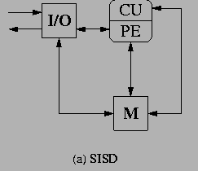
SISD
where CU= Control Unit, PE= Processing Element, M= Memory

Slide 11
SIMD
SIMD (Single-Instruction stream, Multiple-Data streams)
Each instruction is executed on a different set of data by different processors i.e multiple processing units of the same type process on multiple-data streams.
This group is dedicated to array processing machines.
Sometimes, vector processors can also be seen as a part of this group.

Slide 12
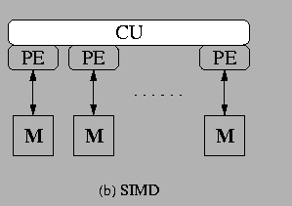
SIMD

Slide 13
MISD
MISD (Multiple-Instruction streams, Singe-Data stream)
Each processor executes a different sequence of instructions.
In case of MISD computers, multiple processing units operate on one single-data stream .
In practice, this kind of organization has never been used

Slide 14
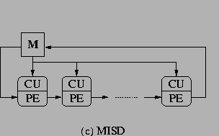
MISD

Slide 15
MIMD
MIMD (Multiple-Instruction streams, Multiple-Data streams)
Each processor has a separate program.
An instruction stream is generated from each program.
Each instruction operates on different data.
This last machine type builds the group for the traditional multi-processors. Several processing units operate on multiple-data streams.

Slide 16
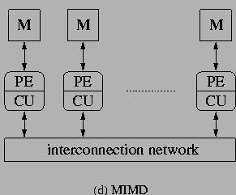
MIMD

Slide 17
ILP
More parallelism (or more work per pipeline stage):fewer clocks/instruction [more instructions/cycle]
Launching multiple instructions per stage allows the instruction execution rate, CPI, to be less than 1
Increase the depth of the pipeline to increase the clock rate –super-pipelining
ILP is a measure of the number of instructions that can be performed during a single clock cycle.
Parallel instructions are a set of instructions that do not depend on each other to be executed.

Slide 18
ILP Hierarchy
Bit level Parallelism
16 bit add on 8 bit processor
Instruction level Parallelism
Loop level Parallelism
for (i=1; i<=1000; i= i+1) x[i] = x[i] + y[i];
Thread level Parallelism (SMT, multi-core computers)

Slide 19
Making Computers Think Parallel
Human
Write code yourself, directly controlling each processor
Compiler
Let the compiler convert your sequential code into parallel instructions.
Hardware

Slide 20
Implementations of ILP
Pipelining
-Super pipelining
Superscalar Architecture
Dependency checking on chip.
Multiple Processing Elements eg. ALU, Shift
VLIW (Very Long Instruction Word Architecture)
Simple hardware, Complex Compiler
Multi processor computers

Slide 21

References
Advanced Computer Architecture – Kai Hwang
Computer Architecture & Organization – John P. Hayes
Computer System Architecture – M. Morris Mano
Computer Organization & Architecture – T. K. Ghosh
Computer Organization & Architecture – Xpress Learning

